Slide 1
Virtual Medicine - The future of care delivery and care setting, hospital and home
September 23, 2021

Slide 2





Vision
Mission
To realize the full health
potential of every human, everywhere.
Reform the global health ecosystem through the power of information and technology.

Slide 3
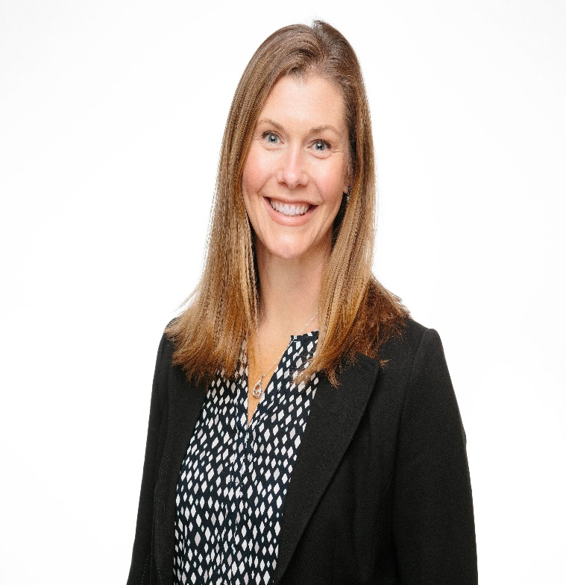
Welcome
Gwynne Jelbaoui
Program Manager
Clinical Informatics HIMSS
Gwynne.Jelbaoui@himss.org

Slide 4





Physician Community
Education
Community
Present webinars on telehealth, medical informatics, clinical decision support and best use of EHR systems
Volunteer efforts include –CMIO Roundtable & Workgroups, Clinician Circle (ambassador)
Thought Leadership
CMIOs
Value of CMIO; CMIO Roundtable
Policy input, interviews with HIMSS Media; Pre-Con Symposium Planning
Physician Community
Education Task Force
Physician Resources
Drive education and content for Community
Career profiles, education, articles, blogs
Strategic Partners
AMDIS, PEHRC with CMSS, AHA
www.himss.org/membership-participation/physician

Slide 5
Virtual Medicine:
The future of care delivery and care setting, hospital and home
Learning Objectives
Recognize opportunities for virtual care to ensure constancy for chronic disease management with higher patient engagement and more efficient use of healthcare resources.
Gain insight of interoperability opportunities with home health devices and EMRs.
Discuss the future of acute care telemedicine and its global reach

Slide 6
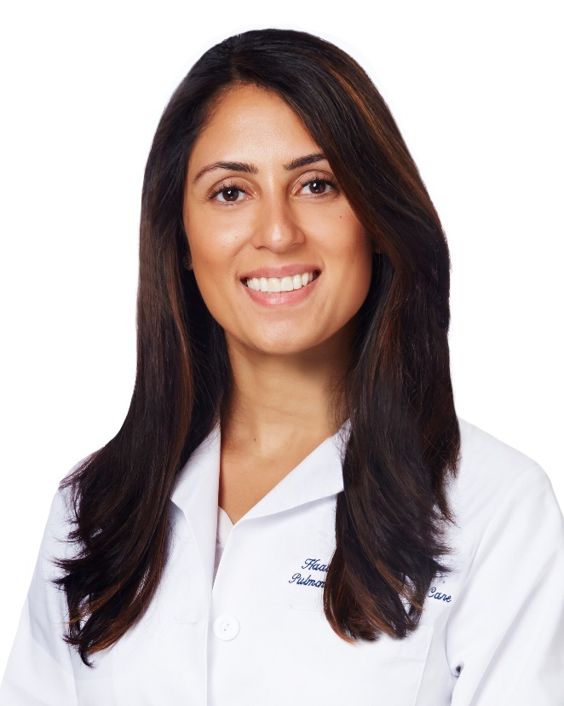
Haala Rokadia, MD
Pulmonary and Critical Care Specialist; Tele-ICU Program Director
Sound Physicians
HIMSS Physician Committee Member

Slide 7
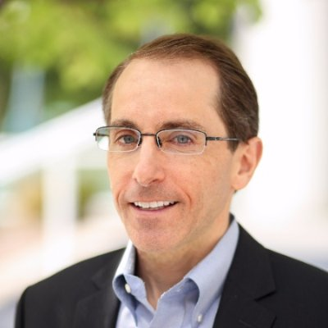
Brian Levy, MD
Lead Physician Executive
Cerner
Telemedicine Provider
Global Services
HIMSS Physician Committee Member
Notes:
Dr. Levy is an executive Healthcare Physician with deep expertise in creating software and content. He is passionate about improving the delivery of healthcare for patients, improving their outcomes, and achieving semantic interoperability of their records.
As the former Chief Medical Officer, he helped lead Health Language from a healthcare IT startup to successful acquisition. He has deep expertise in the use of terminologies to achieve interoperability in the provider, payer, and government sectors.
Dr. Levy currently provides expertise to several healthcare IT companies and he continues to practice medicine as well using use the latest Telehealth technology in delivering every day patient care.

Slide 8
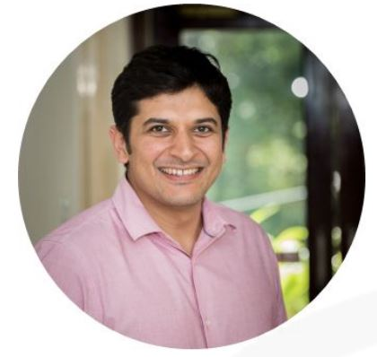
Dhruv Joshi, MD
Co-founder and CEO, Cloudphysician Healthcare
Notes:
Dhruv Joshi is the co-founder and CEO of Cloudphysician, a healthcare technology company that remotely provides ICU expertise to hospitals that do not have access to ICU specialist doctors.
Dhruv has a keen interest in the improvement of quality-of-care delivery. He has extensive experience with healthcare technology platforms across the world and has accumulated over 10,000 hours of providing remote critical care across the US and India.
Dhruv trained in Pulmonary and Critical Care at the Cleveland Clinic Foundation, USA. He graduated medical school from St John’s Medical College, Bangalore, India, following which he completed his Internal Medicine training at the Good Samaritan Hospital, USA.

Slide 9
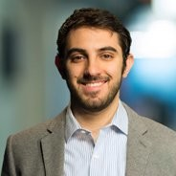
David Gray
Director, Government Relations & Connected Health Policy
HIMSS
Notes:
David oversees the HIMSS Congressional advocacy and education initiatives, and manages relationship development opportunities for the GR team.
He sits on the Connected Health Initiative Steering Committee and SPROUT Telehealth Policy Committee, and serves as co-chair of the Maternal Applications of Technology for Community Health (MATCH) Coalition.
Prior to joining HIMSS, David worked at the Telecommunications Industry Association and held various positions on Capitol Hill, including in the House Democratic Cloakroom and for Congresswoman Chellie Pingree (D-ME). He started his career in Washington, DC as an intern in the Office of Speaker Nancy Pelosi (D-CA).

Slide 10


Panel Discussion

Slide 11
Questions from the attendees?

Slide 12

Thank you speakers!
Haala Rokadia, MD
Brian Levy, MD
Dhruv Joshi, MD
David Gray

Slide 13

Join Accelerate and the Physician Community www.youraccelerate.com
Accelerate is grounded in connecting our evolving community to provide opportunities for professional networking and development, thought leadership and research, and supporting digital transformation.

Slide 14

Thank you!
Contact emails:
Physician Community informatics@himss.org
Gwynne Jelbaoui
Gwynne.Jelbaoui@himss.org

