Slide 1
Interoperability Breakthroughs to Advance Value-Based Care and Improve Clinical and Financial Outcomes
HIMSS Interoperability & HIE Community Fall 2020 Roundtable | October 21, 2020

Slide 2

HIMSS Interoperability & Health Information Exchange Community
Connecting professionals committed to transforming health through standards-based interoperability and health information exchange
A dynamic community for sharing ideas, learning best practices and leveraging collaborative opportunities
https://www.himss.org/membership-participation/communities
Join Today

Slide 3

Interoperability & HIE Committee – Applications Live Now!
Open until November 8, 2020
Annual Call for Committee Volunteers is open to anyone who has been an Individual Member for more than the past 12 consecutive months (as of October 1, 2019).
For more information, visit HIMSS.org → Membership Participation → Committees

Slide 4


Concepts
We’re prioritizing
health and safety.
The HIMSS Global Conference & Exhibition
will be held August 9-13, 2021
himssconference.org

Slide 5
Concepts
Share your expertise.
Call for Proposals
General Sessions: October 5 - November 2
Optional Events: January 2021
himssconference.org

Slide 6

Drive outcomes and innovation
Machine Learning & AI for Healthcare
December 1-2 himss.org/events

Slide 7

Protect and manage risk
Healthcare Security Forum
December 7-8 himss.org/events

Slide 8




Meet Our Speakers
Patrick Murta
Adam Bazer
Amit Trivedi
Chief Interoperability Architect & Fellow, Humana, Co-chief Architect, FAST, Da Vinci Coordinating Committee Member
Senior Manager, Informatics, HIMSS
Director, HIT Standards and Informatics, HIMSS

Slide 9
Learning Objectives
Explore the reasons behind global interest from stakeholders across the healthcare information and technology industry in the HL7® FHIR® standard.
Learn how the API model and HL7® FHIR® standard are transformative to healthcare.
Discuss the ways in which FHIR® enables use cases in support of value based care, including “in-workflow’ integration.
Discover recent and upcoming Global Consortium for eHealth Interoperability activities with which your organization can get involved.

Slide 10
HL7 DA VINCI PROJECT
HIMSS Interoperability & HIE Roundtable
October 21, 2020

Slide 11
Spectrum of Healthcare Integration
Today’s Discussion
Integrated Care Delivery with FHIR®
Administrative
  HIPAA & X12
  Claims, Prior Authorization,
  Eligibility & Benefits, etc.
Clinical
  HL7 V2 and V3
  ADTs, CCDs, & etc.
Contemporary
  FHIR & Associated Approaches
Notes:
Patrick Speaker Notes:
Explain where FHIR/Contemporary fits on the continuum
Explain that others to the left have their place but contemporary allows in workflow, integrated care

Slide 12
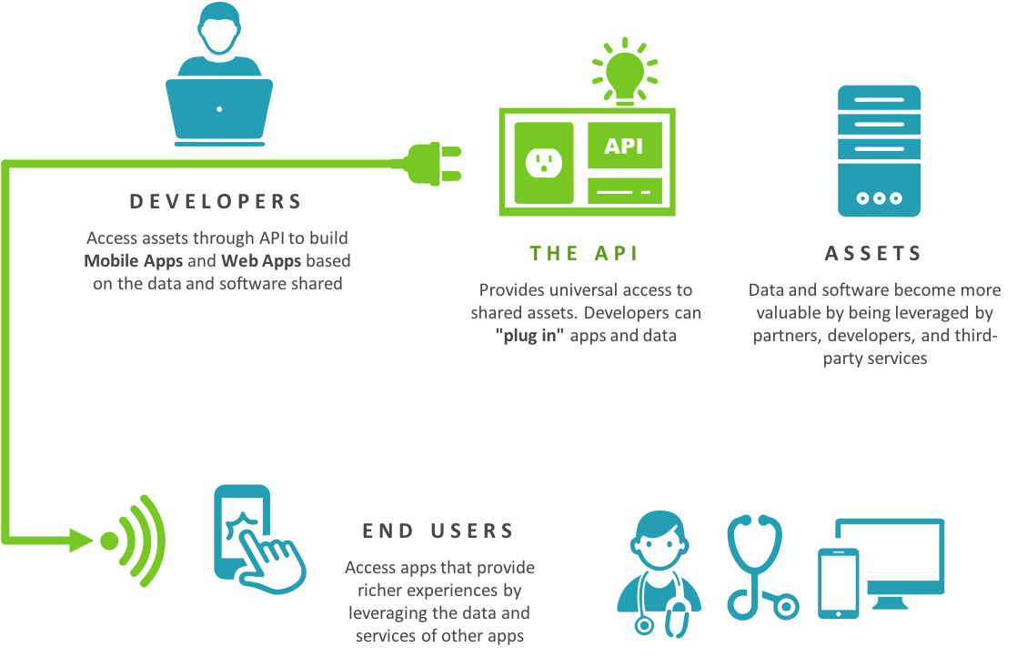










Enabling Seamless Data Exchange and Connections
API
Application Programming Interface
FHIR
Fast Healthcare Interoperability Resources
A software intermediary that allows applications to seamlessly access another application’s capabilities or data, regardless of underlying technologies
Enables developers to simply “plug in” their apps and data
Contemporary industry standard API and data model that supports common exchange methods (e.g., mobile phone apps, EHR-based data sharing, institutional solutions)
Ensures standardization and reusability
Provider
Payers
Healthcare
Directory
Clinical Decision Support
Patient Medical Record
Social Determinants of Health
Referral / Consult
Public Health
Research

Slide 13

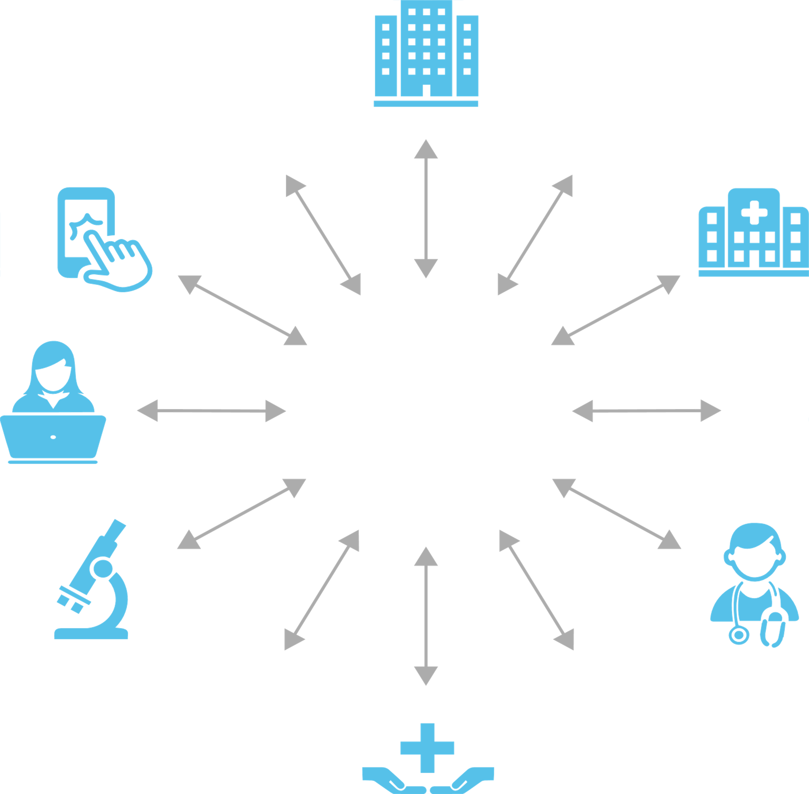

















FHIR® & the Healthcare Ecosystem
Technical Connectivity
Community Connectivity
Payers
Provider
Healthcare
Directory
Health Systems
Payers
Patients
CDS
Patient Medical Record
Research
Providers
Services
(e.g., DME, Imaging)
Referral/ Consult
Public
Health
Research
Public Health

Slide 14



Project Challenge
To ensure the success of the industry’s shift to Value Based Care
Transform out of Controlled Chaos:
Develop rapid multi-stakeholder process to identify, exercise and implement initial use cases.
Collaboration:
Minimize the development and deployment of unique solutions.
Promote industry wide standards and adoption.
Success Measures:
Use of FHIR®, implementation guides and pilot projects.
Notes:
Da Vinci simply is an group of industry payers, providers and HIT partners that understand how critical it is to develop common, ideally eventual standard ways for providers and payers to exchange the critical data required for value base case to work.

Slide 15








Program Timeline
1st Da Vinci Focused Connectathon @ Guidewell
Da Vinci Founded
Publish IGs and Expand Implementor Support
Initial 2 Use Cases Balloted
HIMSS20 Virtual Demonstrations
Q4
2017
Q2
2018
Q4
2018
Q2
2019
Q4
2019
Q2
2020
Q4
2020
Q1
2018
Q3
2018
Q1
2019
Q3
2019
Q1
2020
Q3
2020
Initial Working Session @ Optum Labs
Initial Production Deployments & Education Events
Concept Proposed
HIMSS19 Demonstrations
By Sept19 HL7 12 IGs Progressing Balloting
Progress To Date
Year End Focus
Notes:
Add CMS/ONC deadlines in next version?

Slide 16

















































Da Vinci 2020 Multi-Stakeholder Membership
EHRs
PAYERS
PROVIDERS
*
*
*
*
*
*
*
*
*
*
*
*
*
*
*
DEPLOYMENT
VENDORS
*
*
*
*
*
INDUSTRY PARTNERS
*Indicates a founding member of the Da Vinci Project.
Organization shown in primary Da Vinci role, Many members participate across categories.
For current membership: http://www.hl7.org/about/davinci/members.cfm
*
Notes:
Add OrthoNovo, confirm Cognizant

Slide 17
Use Case Focus Areas
Quality Improvement
Member Access
Clinical Data Exchange
Data Exchange for Quality Measures STU2
Clinical Data
Exchange
Payer Data
Exchange
Payer Data
Exchange
Payer Data Exchange: Formulary
Payer Data Exchange: Directory
Clinical Data
Exchange
Gaps in Care & Information
Payer Coverage Decision Exchange
Process Improvement
Patient Cost Transparency
Notifications
Coverage Requirements Discovery STU2
Coverage / Burden Reduction
Patient Data Exchange
Risk Based Contract Member Identification
Chronic Illness Documentation for
Risk Adjustment
Documentation Templates and Rules
Performing Laboratory Reporting
Prior-Authorization Support
Use Case
HL7 Standards Progress
Published
Balloting
Aligned with specific ONC or CMS rule
Build
Future

Slide 18







Use Case
Maturity
Standard Phase
Connectathon | <1 | 2-4 | 5+
Live | <1 | 1-3 | >4
Progress
Future
Build
Ballot
Published
Quality Improvement
Member Access
Clinical Data Exchange
Clinical Data
Exchange
Payer Data Exchange
Directory
Payer Data Exchange
Clinical Data Exchange
Data Exchange for Quality Measures
Gaps in Care & Information
Coverage/Burden Reduction
Formulary
Coverage Decision Exchange
Price Cost Transparency
Notifications
Patient Data Exchange
Process Improvement
  Coverage Requirements Discovery
Documentation Templates and Rules
Performing Laboratory Reporting
Risk Based Contract Member Identification
Risk Adjustment for Chronic Illness Documentation
Aligned with specific ONC or CMS rule
Prior-Authorization Support

Slide 19











Da Vinci Demonstrations: Lara’s Patient Journey
Benefits of Implementing Da Vinci
Create transparency and reduce burden for patients, providers and payers across all sets of patient experience
Saves money and time by minimizing the development of one-off solutions
Leverage the collective expertise and efforts of industry experts and HL7 FHIR
Reduce burden and waste by focusing on known high volume, manual activities that can be automated,
Allow efficient, effective real-time data exchange to effect patient outcomes and support VBC
Hospital
PCP
ER
Lara
Cardiologist
HIMSS20 Member Demonstrations | Stats
Number of Members | 46
Members Demonstrating | 22+
Number of Demos | 30+
Panel Discussions | 5
Use Cases in Flight | 14
Payer B
Payer A
https://confluence.hl7.org/display/DVP/Da+Vinci+2020+Calendar

Slide 20












Patient Journey Today
Patient Care
Discharge Planning
Telehealth
Payer
COVID
Patient
ER
Labs 2
COVID Unit
PCP
Labs 1
Population Data
EMS
Public Health
Resource Management/Crisis Planning
Notes:
Humana – short term tactical changes, key points able to quickly use our interop platform to do integrations to figure out what FHIR resources to share info with orgs, used agile, to share actionable data quickly to all parties. . .
Current state – fragmented state, given COVID 19 spotlighted acute issues don’t have standards based interop way we need, could share info quickly, if we had PDEX an CDEX in workflow. . . Applicable beyond COVID, any unfamiliar territory, not at individual, but look at population level on human and capacity planning to see activity in volume, public health and. . .look exposed shortcomings to everyone. . .things we tolerate before. . .look at all thing things we tolerated to date

Slide 21
Patient Journey: FHIR & API Enabled
Patient Care
Represents opportunity where FHIR APIs can replace Fax, Phone and Data Flow Blockers . For COVID focused use cases Da Vinci offers the following:
HL7 Da Vinci Implementation Guides
Payer to Payer Data Exchange (PDex)
Clinical Data Exchange (CDex),
Notifications,
Gaps in Care,
Data Exchange for Quality Measures (DEQM)
Discharge Planning
Payer
Telehealth
COVID Unit
COVID
Patient
Labs 1
Labs 2
ER
PCP
Population Data
EMS
Public Health
Resource Management/Crisis Planning
Notes:
Humana – short term tactical changes, key points able to quickly use our interop platform to do integrations to figure out what FHIR resources to share info with orgs, used agile, to share actionable data quickly to all parties. . .
Current state – fragmented state, given COVID 19 spotlighted acute issues don’t have standards based interop way we need, could share info quickly, if we had PDEX an CDEX in workflow. . . Applicable beyond COVID, any unfamiliar territory, not at individual, but look at population level on human and capacity planning to see activity in volume, public health and. . .look exposed shortcomings to everyone. . .things we tolerate before. . .look at all thing things we tolerated to date

Slide 22
Da Vinci Support of Regulation: Patient Access
Applies To
CMS-regulated payers, specifically MA organizations
Medicaid Fee-for-Service (FFS) programs
Medicaid managed care plans
CHIP FFS programs
CHIP managed care entities and
QHP issuers on the FFEs, excluding issuers offering only Stand-alone dental plans (SADPs) and QHP issuers offering coverage in the Federally-facilitated Small Business Health Options Program (FF-SHOP)
Implement and Maintain
A secure, standards-based (HL7 FHIR Release 4.0.1) API that allows patients to easily access their claims and encounter information, including cost, as well as a defined sub-set of their clinical information through third-party applications of their choice.
Beginning January 1, 2021 (enforcement discretion for 6 months)
QHP issuers on the FFEs, plan years beginning on or after January 1, 2021
https://www.cms.gov/newsroom/fact-sheets/interoperability-and-patient-access-fact-sheet
22

Slide 23


Implementation Guides (IG) Options for Patient Directed APIs
FHIR IG
FHIR Resource Definition
Da Vinci
Directory
(PLAN NET)
Patient Direct API 1/1/21
Directory Access API
Da Vinci
Formulary
Other related regulation
PAYER
Individual
Product
Plan Design
Consumer
Apps
FHIR Accelerator Commentary
Goal is to reduce burden on payers, providers, vendors and patients to meet 1/1/21 requirements, image excludes 1/1/22 requirements
There are no specific CMS/ONC requirements to use any HL7 Implementation Guide
FHIR Community is working collaboratively to ensure the specific guides meet needs of the proposed rule.
All guides are Standard for Trial Use (STU), or moving towards a published STU version
NOTE: CARIN Real Time Benefit Check does not fall under 1/1/21 Patient Directed API regulations but support other emerging rules.
Da Vinci
Payer Data Exchange
PDEX* for Clinical Data
Provider
Operational
Support
Provider
System
CARIN IG for
Blue Button ® for Payer and Pharmacy Claims Data
OAUTH Security Layer
Member
Portal
PBM
Operational
Support
CARIN
Real Time Benefit Check for Pharmacy
PBM
Patient
Portal
Notes:
Need Notifications here? Don’t think so, with next batch for 1/1/22
Add people. . .

Slide 24
Da Vinci Clinical Data Exchange
24

Slide 25
Health Record Exchange (HRex)
Benefits
Creates a consistent framework to exchange clinical data between Providers and Payers
Enables consistent, constrained use of FHIR and US CORE profiled data specific resources across all Da Vinci data exchange Implementation Guides
Focuses on nuance of resources like Provenance which differs by collection source, or resources currently not yet in USCDI and US Core e.g., Coverage
FHIR
Da Vinci Profiles
US CORE
Notes:
Reuse conceptual frameworks, minimize data exchange to just required elements, not a big blob of attachments.

Slide 26



Clinical Data Exchange (CDex)
Benefits
Payers can be explicit about the data they are requesting, as opposed to general requests which often result in providers sending more information than might be necessary to make sure claims are supported
Improves quality of information shared by using FHIR standard
e.g., What are
the patient’s
active conditions?
e.g., What are the patient’s HbA1C results after 2020-01-01?
e.g., Send the patient’s latest History & Physical
Payer Initiates Request
Provider System Retrieves Clinical Information
Provider May Reviews Data Prior to Sending to Payer
Provider Responds to Payer
Notes:
CDex – post-payment review as example
Payer initiates a request for information to support post-payment review after patient has been seen claim submitted, claim paid
Payer specifies structured data they want to request (e.g., HbA1C), H&P, Progress Note = based on specific code
Package in FHIR bundle
Provider system retrieves all that clinical information using FHIR
CDex request represents all the queries the provider EHR would execute
Show UI with data that will be bundled up and sent
Acknowledge and send via FHIR to payer
Provider concerns re: minimum necessary
IG allows us provides us to be explicit about what payer is asking for (e.g., document types, specific range of dates) as opposed to today – please send info to support claim, and provider often sends more than what might be necessary to make sure claim is supported
We give option for provider to review what’s returned to the payer
In future VBC – trust gap is closed – this could be done automatically based on contractual agreements

Slide 27
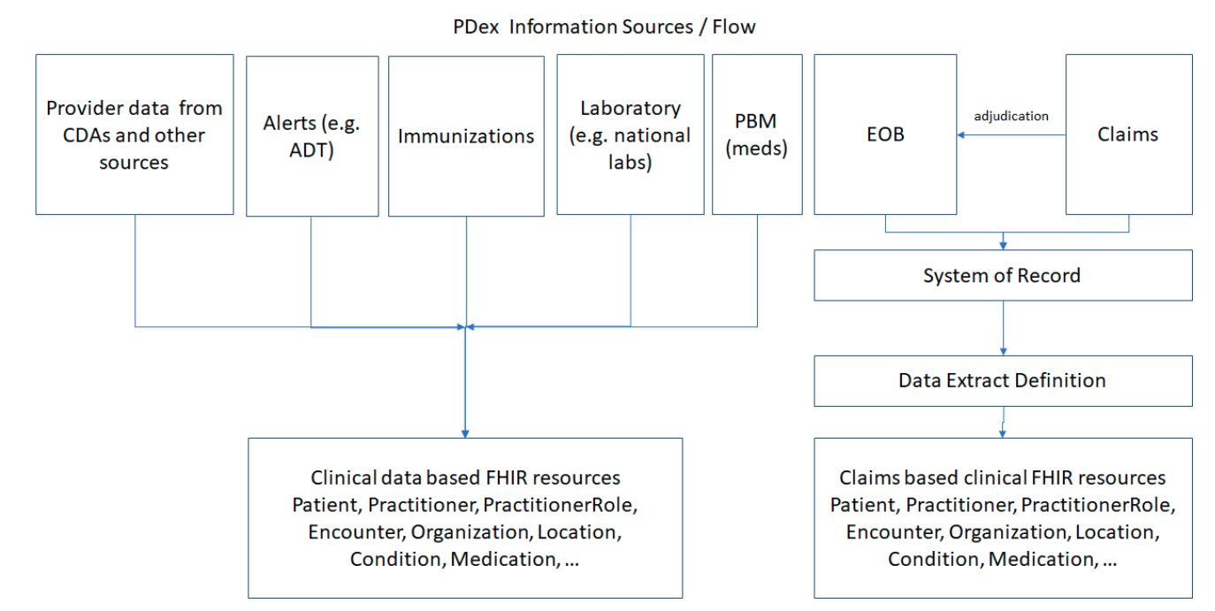

Payer Data Exchange (PDex)
Benefits
Creates a full picture of all patient activities
Providers may be unaware of all the patient clinical activities outside their facility
Addition of payer-based data expands the scope of information available to the patient and provider to support clinical decision-making and care planning
Improves quality of information shared by using FHIR standard
Provider data from CDAs and other sources
Alerts (eg, ADT)
Patient Visits Provider
Clinical data based FHIR resources
Immunizations
Payer Makes Data available to Provider
Laboratory (eg, national labs)
PBM (meds)
EOB
System of record
Payer Gathers Data received from Source System(s)
Claims based clinical FHIR resources
Adjudication
Provider
EHR Initiates Request
Data Extract Definition
Claims
PDex Information Sources/Flow

Slide 28
Coverage/ Burden Reduction
Coverage Requirements Discovery
CDS Hooks
Coverage Requirements Discovery
Documentation Templates and Coverage Rules
FHIR APIs
Documentation Templates and Coverage Rules
EHR/PROVIDER BACK OFFICE SYSTEMS
PAYER
Prior Authorization Support
X12 278
Prior Authorization Support
Transformation Layer
Transformation Layer
Optional
X12 275
if required
Improve transparency
Reduce effort for prior authorization
Leverage available clinical content and increase automation

Slide 29
HL7 Da Vinci Education &
Implementation Event
Details
October 27-29th
Industry Updates from CMS, ONC, Da Vinci Program Team
Da Vinci Use Case Deep Dives
Hands On Coding
To Register http://www.hl7.org/events/da-vinci/2020/10/
Discounted fees to HL7 & Da Vinci members
Early Bird Ends Wednesday October 21st
The adoption of H7 FHIR is rapidly accelerating due to recent CMS/ONC Final Rules as well as a recognition of its benefits in reducing clinician burden and improving the exchange of quality measure data.
The goals for this events are:
to educate the health IT community about HL7 FHIR and FHIR implementation guides developed by the Da Vinci Project and the CARIN Alliance
to help participants prepare to meet the CMS/ONC Final Rules
to engage the community to participate in the FHIR community

Slide 30
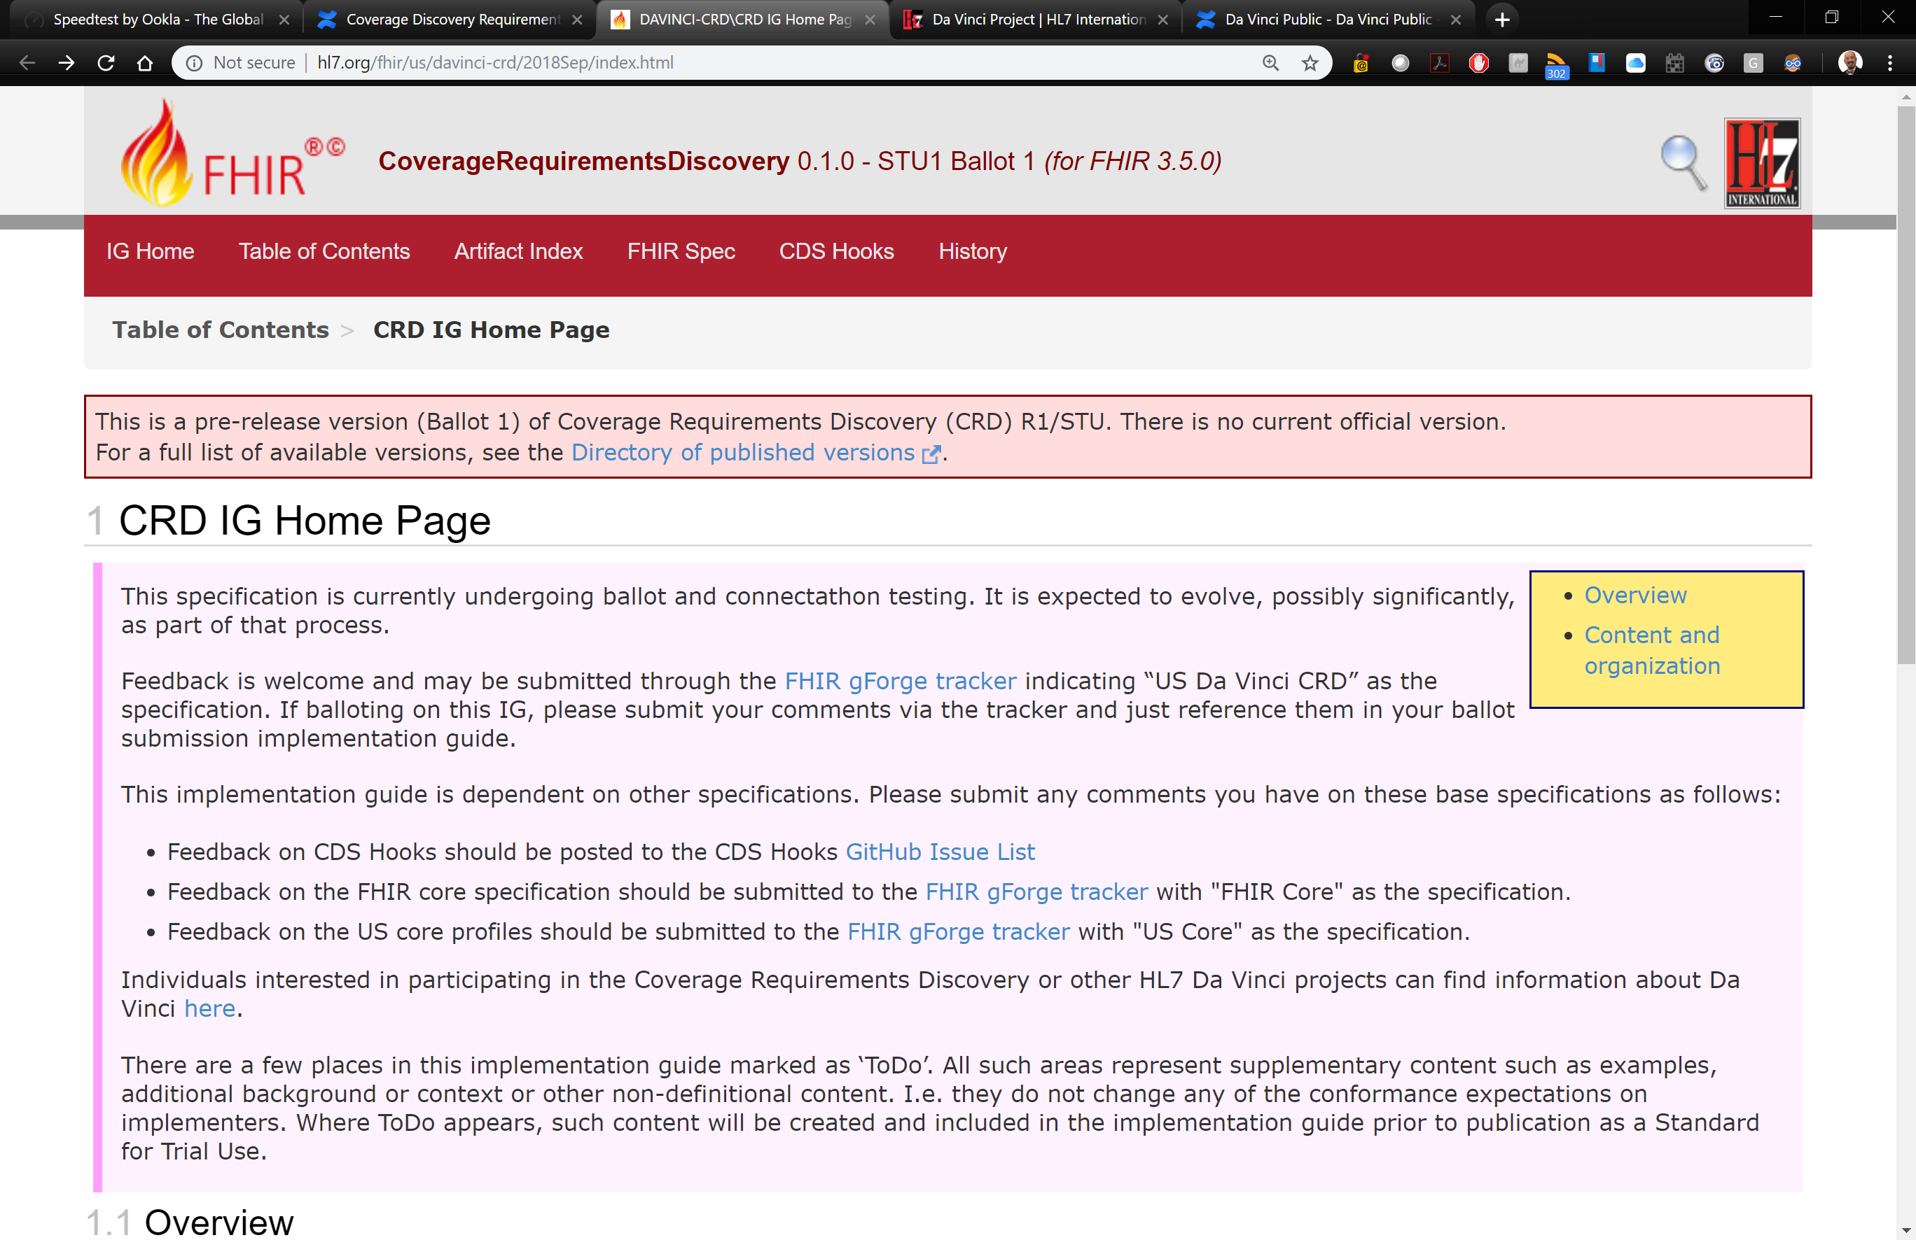
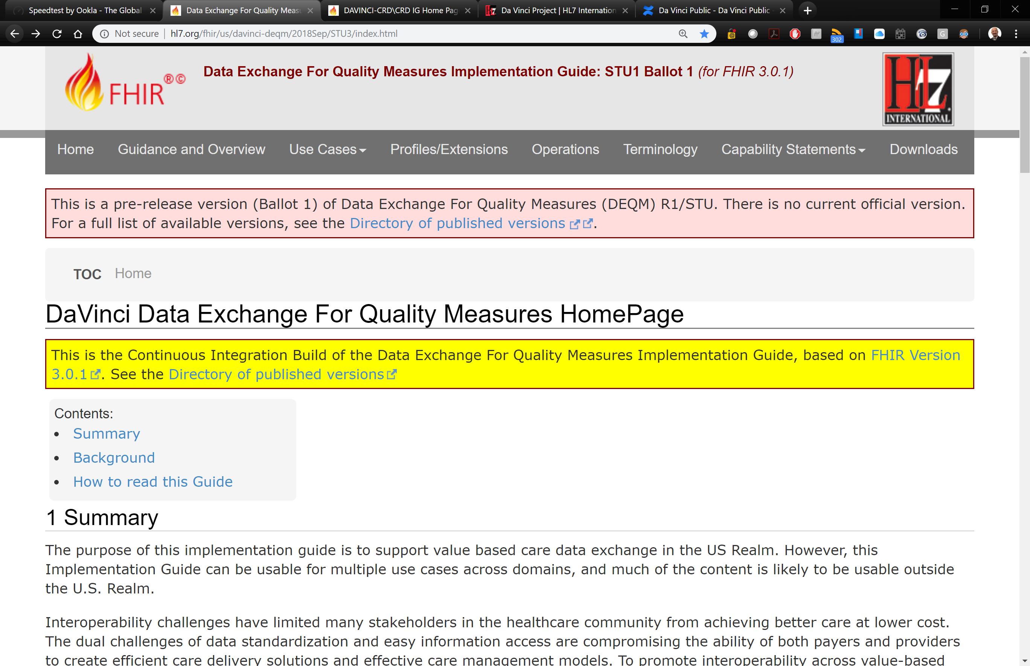
See Progress, Test, Implement
VIEW
Live Demos
Member Panels
End to End Clinical Scenario
View Full Schedule
hl7.me/davincinews
FIND
Listserv Sign Up
Background collateral
Active Use Case content
Implementation Guides
Reference Implementations
Calendar of Activities & Updates
KEY RESOURCES
HL7 Confluence Site - https://confluence.hl7.org/display/DVP/
Where to find Da Vinci in Industry - https://confluence.hl7.org/display/DVP/Da+Vinci+2020+Calendar
Use Case Summary and Links to Call In & Artifacts - https://confluence.hl7.org/display/DVP/Da+Vinci+Use+Cases
Reference Implementation Code Repository - https://github.com/HL7-DaVinci
30

Slide 31
Da Vinci Implementation Guides
IG | Status | # Times Tested
Quality Improvement
Data Exchange for Quality Measures (DEQM) | STU 2 Ballot 1 based on FHIR R4 | 7
Gaps in Care | Active Development | N/A
Coverage/ Burden Reduction
Coverage Requirements Discovery (CRD) | STU 1 Ballot 2 based on FHIR R4 | 7
Documentation Templates & Rules (DTR) | STU 1 Ballot 2 based on FHIR R4 | 6
Prior Authorization Support (PAS) | STU 1 Ballot 1 based on FHIR R4 | 4
Member Access
Health Record Exchange Framework (HRex) | STU 1 Ballot 1 based on FHIR R4 | N/A
Clinical Data Exchange (CDex) | STU 1 Ballot 1 based on FHIR R4 | 5
Payer Data Exchange (PDex) | STU 1 Ballot 1 based on FHIR R4 | 5
Payer Data Exchange (PDex): Formulary | STU 1 Ballot 1 based on FHIR R4 | 4
IG | Status | # Times Tested
Payer Data Exchange (PDex): Plan Network Directory | STU 1 Ballot 1 based on FHIR R4 | 4
Payer-Payer Coverage Decision Exchange | STU 1 Ballot 1 based on FHIR R4 | 4
Patient Cost Transparency | Planning | N/A
Clinical Data Exchange
Notifications | STU 1 Ballot 1 based on FHIR R4 | 4
Patient Data Exchange | Planning | N/A
Performing Laboratory Reporting | Planning | N/A
Process Improvement
Risk Based Contract Member Identification | STU 1 Ballot 1 based on FHIR R4 | 2
Chronic Illness Documentation Risk Adjustment | Planning | N/A

Slide 32
Da Vinci Program Manager:
Jocelyn Keegan, Point of Care Partners
jocelyn.keegan@pocp.com
Da Vinci Technical Lead:
Dr. Viet Nguyen, Stratametrics LLC
vietnguyen@stratametrics.com
32

Slide 33
What is FAST?
The FHIR at Scale Taskforce (FAST), convened by the Office of the National Coordinator for Health IT (ONC), brings together a highly representative group of motivated healthcare industry stakeholders and health information technology experts.
The group is set to identify HL7® FAST Healthcare Interoperability Resources (FHIR ®) scalability gaps and possible solutions, analysis that will address current barriers and will accelerate FHIR adoption at scale.

Slide 34
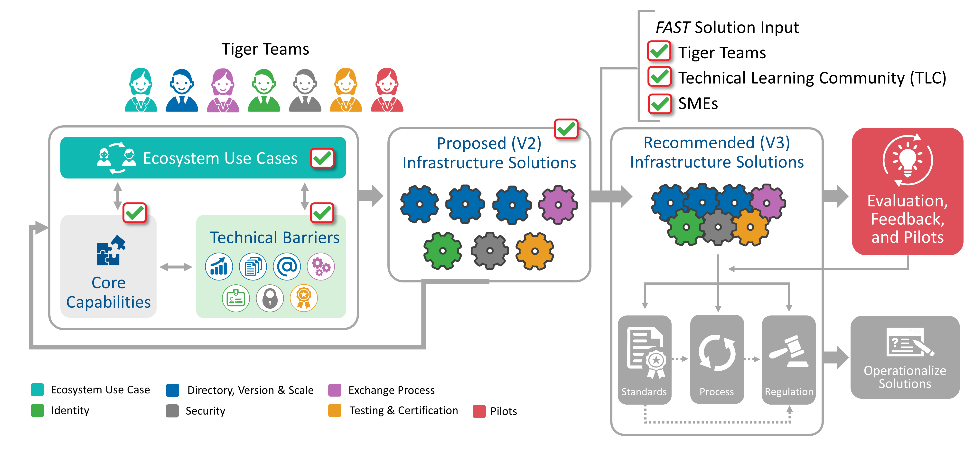
FAST Solution Process
FAST Action Plan
34

Slide 35

















FAST Organization & Community Engagement
EXECUTIVE STEERING COMMITTEE
(public-private mix)
FEEDBACK
COORDINATING COMMITTEE
(public-private mix)
Information Sharing with TLC through:
Website
Periodic Webinars
Newsletters
TLC Meetings
LinkedIn Group
UPDATES
SEVEN TIGER TEAMS
Ecosystem Use Cases
Identity
Security
Directory, Versioning and Scale
Exchange
Certification and Testing
Pilots
TECHNICAL LEARNING COMMUNITY (TLC)
SUBJECT MATTER EXPERTS (SME) Panels
Notes:
STEPHEN
How is FAST organized? We have an Executive Steering Committee and Coordinating Committee made up of public and private committee members with 7 Tiger Teams focused on the technical barrier areas we've already discussed. Tiger Teams do share information and engage each other when a solution may overlap more than one focus area. Tiger Teams work to identify Use Cases, Technical and Regulatory Barriers, Core Capabilities and where gaps exist. The work the Tiger Teams does will be shared on a regular basis with the Technical Learning Community to maintain transparency and also to gain feedback.
Old notes:
COULD BE BEGINNING OF SECTION BEFORE DRILLING DOWN: Mindmap, graphical representation of how these things fit together. Technical barriers drove use cases which drove clarity around what is actually needed, which leads to industry feedback/sanity check. Could be a build slide. This overlaps with an earlier slide
[This slide will show the flow for how the teams will reach solution recommendations. Start with technical barriers drove creation of >Use cases with gave clarity to>possible solutions which needs> Industry feedback/sanity check]

Slide 36







Lack of Consistent Infrastructure Impacts Flow

Slide 37

Well-Planned Infrastructure Creates Efficiency

Slide 38















Example FHIR Transaction Journey
Patient visits Primary Care Physician (PCP)
PCP needs information from Payer
Payer receives PCP request
REQUESTING SYSTEM
RECEIVING SYSTEM
1
2
3
4
5a
5b
6
Formulates FHIR Request
Looks Up the FHIR Endpoint for Recipient
Transaction Information
(eg, Header) Appropriately Configured
Receives Transaction, Validates Requestor, Validates Version
Performs Patient Matching and Sends Back Not Found If Unable To Do So
Authenticates FHIR User’s Role
Filters Out Data That Does Not Have Consent
Generates & Returns FHIR Response
DIRECTORY
7
EXCHANGE
IDENTITY
PCP views patient information
Requesting System Receives Data
VERSIONING
DIRECTORY
EXCHANGE
VERSIONING
CONFORMANCE & CERTIFICATION
SECURITY
PILOTS

Slide 39










FAST Proposed Solutions (currently v2)
Directory, Version & Scale (3)
Identity (4)
Exchange Process (1)
Testing & Certification (1)
Security (4)
A US Wide Solution for FHIR Endpoint Discovery (Version 2)
An HL7 FHIR Standard Based Solution for Intermediary-to-Intermediary Exchange and Reliable Routing with Metadata (Version 3 Draft)
A US Wide Methodology for Supporting Multiple Production Versions of FHIR (Version 2
Proposed
Infrastructure Solutions
- Reliable Routing with Metadata Across Intermediaries
US Wide Scaling Requirements for FHIR RESTful Exchange Intermediaries (Version 2)
A Scalable FHIR Testing & Certification Platform (Version 2)
Standards Based Approaches for Individual Identity Management (Version 2)
US Wide Model(s) for Scalable Security Solutions (Version 3 Draft)
- Mediated Patient Matching
- Collaborative Patient Matching
- Networked Identity Management
- Distributed Identity Management
- UDAP Trusted Dynamic Client Registration
- UDAP Tiered OAuth for User Authentication
- UDAP JWT-Based Client Authentication
- UDAP JWT-Based Authorization Assertions

Slide 40

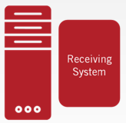
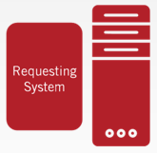





Conceptual Integrated Architecture
Security (Authenticate/Authorize)
UDAP Trusted Dynamic Client Registration - UDAP Tiered OAuth User Authentication - UDAP JWT-Based Client Authentication - UDAP JWT-Based Authorization Assertions
Exchange Routing Meta Data
RESTful Headers – FHIR Meta Tags
Intermediaries
Identity
Collaborative/Mediated Patient Matching – Collaborative/Mediated Identity Management
National Directory
Endpoints – Profiles – Versioning – Trust - Conformance
CONFORMANCE & CERTIFICATION (Testing & Certification Program)
PILOTS (FAST Capability Vetting with Existing HL7 Accelerators)

Slide 41
Example CDS/FHIR Transaction Journey – PDex (Da Vinci Payer Data Exchange)
Patient visits Primary Care Physician (PCP)
PCP needs prior auth requirements information from Payer
Payer receives PCP requests
Payer PDex Interactions
Payer receives CDS request and creates CDS card
CDS Card is returned in real time & PDex bundle is available
REQUESTING SYSTEM
RECEIVING SYSTEM
EHR PDex Interactions
[START] PCP’s EHR requests CDS Card from payer
CDS Card is processed & PDex bundle is made available to EHR for visualization and integration [END]
1
2
3
4
5a
5b
6
Formulates FHIR Request
Looks Up the FHIR Endpoint for Recipient
Transaction Information
(eg, Header) Appropriately Configured
Receives Transaction, Validates Requestor, Validates Version
Performs Patient Matching and Sends Back Not Found If Unable To Do So
Authenticates FHIR User’s Role
Filters Out Data That Does Not Have Consent
Generates & Returns FHIR Response
DIRECTORY
7
EXCHANGE
IDENTITY
PCP views patient information
Requesting System Receives Data
VERSIONING
DIRECTORY
EXCHANGE
VERSIONING
CONFORMANCE & CERTIFICATION
SECURITY
PILOTS
Notes:
Once authorization and authentication have successfully been performed, the receiving system can generate the FHIR response and send back the request going through many of the steps that occurred with the initial request (finding the correct endpoint, etc.)
You'll see pilots running across the bottom of this slide. All of the possible solutions identified will need to be piloted to ensure the approach is sound for multiple stakeholders.
8/7 DM Notes:
Changed patient scenario to care manager/ care coordinator – need to revisit doctor/heart/test tube icons to make sure they’re representative
Need to add Core Capabilities as a bottom “infrastructure” layer
Directory
Endpoint Discovery
Standard Based Endpoint Access
Guaranteed Message Delivery
Versioning
Resource Version Identification
Exchange
Data Provenance
Event/Message/Topic Subscription/Publication
Synchronous Transaction Support
Asynchronous Transaction Support
Reliable Payer Identification
Identity
Reliable Patient Identity Management
Reliable Provider Identity Management
Role/Context Identification
Security
Authentication
Authorization
Conformance & Certification
Readiness Credential
Pilots
Readiness Credential
This is the basic path depicted on the wall chart
Key Message: a specific path with dependencies and sequencing
Suggest they look at this slide while we go thru the phases on the next slides
Talk to slide and talk to highlights (IT capabilities)
Focus on what is different one each slide (do a rev of yellow box and squish. (DAVE)
Paul will do the Jack stuff.

Slide 42
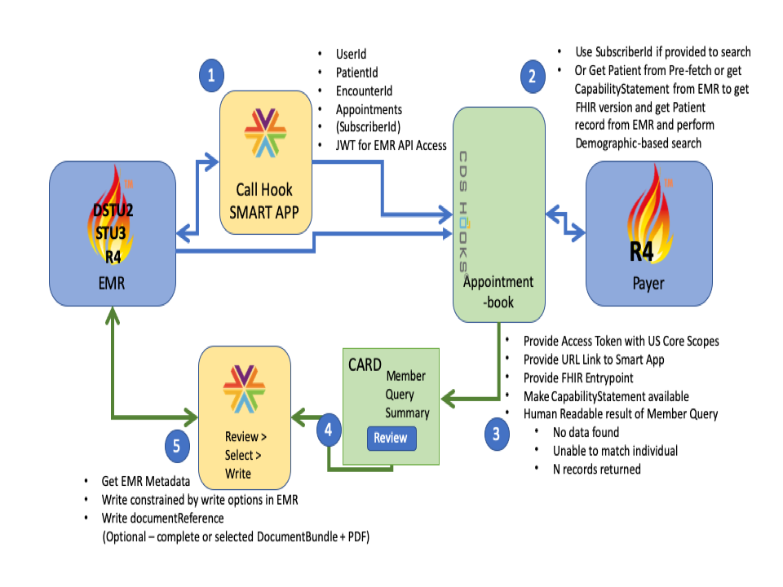
FAST Pilots Support with Da Vinci PDex (Payer Data Exchange)
PDex (Payer Data Exchange)
FAST Solutions Tested
Directory | Versioning | Exchange | Identity | Scale | Security | Conformance & Certification
✓ | ✓ | ✓ | ✓ |  | ✓ | ✓
✓ | ✓ | ✓ | ✓ |  | ✓ | ✓
1
2
3
4
5

Slide 43
FAST Contacts
Stephen Konya
ONC – FAST Lead
Patrick Murta
FAST Chief Architect
Paul Oates
FAST Chief Architect
For more information on the FAST Initiative,
visit the FAST Project Page
WANT TO GET INVOLVED??
Join the Technical Learning Community (TLC) to get updates and provide input on the technical and regulatory barriers, use cases, and proposed solutions as they are developed.
Visit Project Page
SIGN UP!!
JOIN THE LINKEDIN GROUP (400+ members & growing!)
Have any further questions/suggestions?
Please contact Stephen Konya at Stephen.Konya@hhs.gov
& Diana Ciricean at Diana.Ciricean@hhs.gov

Slide 44
HIMSS
Global Consortium for eHealth Interoperability:
Supporting Interoperability Breakthroughs to Advance Value-Based Care
IHIE Community Roundtable Fall 2020
October 21, 2020
Notes:
Supporting Interoperability Breakthroughs to Advance Value-Based Care and Improve Clinical and Financial Outcomes

Slide 45



Realizing the potential of FHIR®
The value of FHIR across healthcare
Easing the barrier of entry
  Internet-enabled technology
  Modern development concepts
  Granular access to health data
  Bridging legacy and modern technologies
45
45
Notes:
The transition to value based care is being accelerated through the use of FHIR. Technologists and policymakers from across the world are looking to find alignment and further coordination to help further national eHealth priorities.

Slide 46
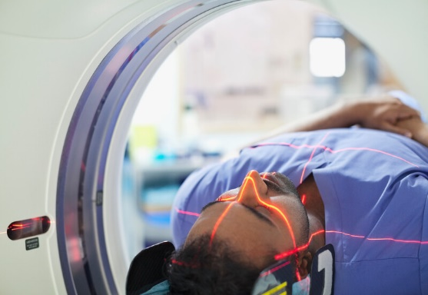





Our
Challenge
Healthcare delivery is complex.
Difficult to change or manage alone.
Resources are limited & must be used efficiently.
The HIMSS team is supporting the advancement of interoperable data and information exchange, for health systems and personalized care applications to help accelerate innovation that has fueled other industries by helping to focus and coordinate the resources, time, and effort of our members.
46
46
Notes:
The transition to value based care is being accelerated through the use of FHIR. Technologists and policymakers from across the world are looking to find alignment and further coordination to help further national eHealth priorities. Consistency and quality across implementations is one of the biggest challenges to implementing FHIR at scale globally

Slide 47

The Global Consortium for eHealth Interoperability
HL7
The HL7 FHIR® standard and associated implementation guides make data sharing easier between parties
Advancing digital health interoperability deployments for patient care, together.
IHE
Use-case based IHE Integration Profiles and Technical Frameworks for clinical data exchange coordinate the use of industry standards for optimal patient care
HIMSS, HL7 International, and IHE International formed the Consortium to help the global community of HL7® FHIR® and IHE integration profile implementers support the advancement of key national, regional and local interoperability initiatives.
The Consortium aligns key HIMSS, HL7 International, and IHE International resources to meet its members’ policy-specific interoperability needs.
HIMSS
HIMSS’ Interoperability Showcase, maturity models, and thought leadership work help drive adoption and improve HL7 and IHE work products worldwide

Slide 48
The Global Consortium for eHealth Interoperability
HL7
Driving Innovation
FHIR-based Standards & Specification Development
FHIR Hackathons
Interoperability in Action
Implementation Guides
Connectathon Interoperability Testing Services
Advancing Awareness
Maturity Models
Communities of Interest
Global Stakeholder Events
Thought Leadership
What Each Partner Is Bringing to the Table
IHE
Goal
To align key HIMSS, HL7 International, and IHE International resources to help federal health agencies around the world achieve policy-specific interoperability needs.
HIMSS
Notes:
Who is this group marketing?

Slide 49
Key Focus Areas for the Consortium
1
2
3
Real-World Testing Tools & Guidance
Interoperability Roadmap Deployment
Collaboration Acceleration
Engage in and share real world testing guidance
Test plan development
Effective testing management
Test partner recruitment
Timely feedback for standards development
    Share successful interoperability roadmaps from around the globe
    Tools
    Online resources
    Subject matter expertise
        Ongoing collaboration on interoperability strategy planning at events
        HIMSS Global Conference
        HL7 International events
        IHE International events
        Other broadly attended international events
Notes:
The Consortium is helping to align resources to support key interoperability projects across the globe – focusing in on the intersection of policy and technology where multinational/multidisciplinary stakeholders are needed to help develop requirements and validate implementation decisions to drive consistent and high quality deployment of standards

Slide 50






How the Consortium Accelerates Action
Standards Roadmaps
Regional Health IT Policy Guidance
Shared, prioritized roadmap and plan that measures interoperability deployment progress accordingly
Relevant and documented regional and national government strategies, programs and plans that can be shared as resources to other nations.
Global Interoperability Standards Guide
Interoperability Measurement/
Maturity Models
Resource of established and emerging healthcare information technology standards to support universal adoption
Consortium
Relevant maturity models and measurement tools to track progress of interoperability deployment activities
Global Interoperability Dashboard
Global Interoperability
Listening Sessions
Updated information on key interoperability projects across the globe. Who is involved, what does it focus on, how you can participate, and more
Convene leading international healthcare and technology policy experts to exchange interoperability policy ideas and priorities that lead to better health outcomes and measurement

Slide 51

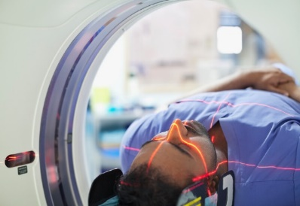





Global Consortium for eHealth Interoperability
The Goal
Align key HIMSS, HL7 International, and IHE International resources to help federal health agencies around the world achieve policy-specific interoperability needs.
How will it work?
Convene experts from provider, technology, and policy organizations across the country and globe to better identify key Interoperability initiatives, efforts to focus resources.
Learn more at www.globalhealthinterop.org
51
51
Notes:
Convene experts from provider, technology, and policy organizations across the country and globe on the front line of the battle against COVID-19
Listen to the data exchange needs/pain points they’ve discovered in this first wave of COVID-19-related patient care
Report to the wider healthcare industry the interoperability best practices gained by these provider organizations and data exchange challenges for the industry to tackle
Listening Sessions
Interoperability Action Dashboard
Focus resources

Slide 52






The Consortium in Action
Accelerating Deployment
Share lessons learned globally from interoperability roadmap deployment to support other members deployment planning
Tool Development
Development of tools, resources, best practices to facilitate early adoption of interoperability standards
FHIR Adoption
Increased global adoption of best practices related to the use of FHIR
Timely Implementation Guidance
Accelerated publication of quality implementation guides with minimal content redundancy
Improved Collaboration
Improved interoperability, testing and information sharing, and matchmaking among stakeholders and early adopters
User Experience Best Practices
Improved workflow and usability of FHIR-enabled apps, and lessons shared from real-world experience
52
52
Notes:
Accelerate Development- support with pilot testing and sharing best practices and lessons learned – back to standards/IG developers
Interop Tools – supporting the ecosystem with more robust, accessible, and timely interoperability testing tools
FHIR® Adoption –Analogous to ONC’s support of FHIR – Europe, Asia, Africa
Timely Implementation Guidance – for example – how to decide or work with conflicting implementation guidance
Improved Collaboration – testing events, information/resource sharing – CONNECTATHONs – so many – can we coordinate better- can we do something to support the vendor community’s participation?
Use Experiences – Listening Sessions -

Slide 53
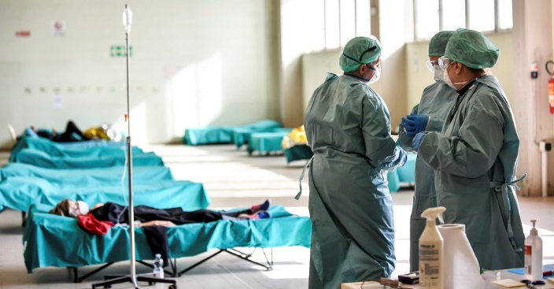
Consortium: Listening Sessions Series
The COVID-19 Response
Convene experts from provider, technology, and policy organizations across the country and globe on the front line of the battle against COVID-19
Listen to the data exchange needs/pain points they’ve discovered in this first wave of COVID-19-related patient care
Report to the wider healthcare industry the interoperability best practices gained by these provider organizations and data exchange challenges for the industry to tackle
The Extraordinary Decisions Facing Italian Doctors, 3/11/20, The Atlantic
CLAUDIO FURLAN / LAPRESSE / AP
53

Slide 54

Global Consortium Listening Sessions
Inaugural Series: On the Frontline of COVID-19
Three-part series
  Clinicians and Provider Organizations on the Frontline of COVID-19: Data exchange needs and pain points
  HIT Professionals and Market Suppliers – Accelerating Interoperability by Leveraging Existing Resources
  How Governments and Ministries of Health are Working with the Industry to Respond to COVID-19
Participating Organizations
  Centers for Medicaid and Medicare Services
  Cerner Corporation
  Executive Office of Health and Human Services, State of Rhode Island
  HealthShare Exchange
  HLN Consulting
  Mt. Sinai Health System
  Ohio State University Wexner Medical Center
  Office of the National Coordinator of Health IT
  Philips
  Sutter Health
  Rhode Island Department of Public Health
Deliverables
  Overview Report
  Sharable Recordings
  Curated Transcripts
  Social Media
Upcoming Topics (For Release)
  Global Digital Health Partnership Video interview series hosted by Tim Kelsey
  International Patient Summary Video interview series hosted by Tim Kelsey
54

Slide 55
Interoperability Initiatives Supported by the Consortium

Slide 56


North American Connectathon
Healthcare industry's largest, most rigorous standards based interoperability testing event for products and systems
IHE Quality Research and Public Health Domain
With CDC support, addresses information exchange and electronic health record content standards necessary to share information relevant to quality improvement in patient care, clinical research and public health monitoring
IHE Profile Development & Acceleration
Vital Records Death Reporting (VRDR), Query for Existing Data for Mobile Profile (QEDm) for Occupational Data for Health
ONC/IHE USA Cooperative Agreement
Accelerating the Adoption of Health IT
Advancing greater standardization and interoperability in areas of national interest, with a focus on real-world interoperability problems.
The IHE USA Team is focusing on the following initiatives to improve interoperability and data exchange
FHIR® Focused IHE Profiles
Personal Health Device Observation Upload (POU), Immunization Content Profile, International Patient Summary, Para-medicine Care Summary, Quality Outcome Reporting for Emergency Management Systems, Routine Inter-facility Patient transport, Mobile Access to health Documents, Mobile Cross-Enterprise Document Data Element Extraction
Test Planning & Partnership Development
HIT Test Tool Cooperative, test partner development for public and private sector organizations - MITRE, NIST, AI, ONC, & others
56

Slide 57

Improving Interoperability
with ONC
IHE USA Cooperative Agreement
  5 year cooperative agreement to support development of new and updated IHE Profiles that support FHIR®
  Accelerate deployment of HL7 FHIR Implementation Guides and IHE Profiles that support the aims of the 21st Century Cures Act
HIMSS Interoperability Measurement Project
  Goal to discover how developers measure the interoperability of their products
  Spring 2021 ONC Interoperability Measurement Workshop to be held at IHE North American Connectathon 2021 – March 1-5, 2021
57
Notes:
IHE USA Cooperative Agreement with ONC (Adam Bazer)
Advance and accelerate FHIR® profile and implementation guide development
Support FHIR® interoperability testing
Publishing IHE products
Improve Accessibility – ease of availability - platforms (pdf/html)
Improve standards products from usability standpoint
Support feedback mechanism from standards development to implementation and back
ONC Interoperability Measurement:
Inform ONC about current and planned efforts by health IT developers to measure the electronic exchange and use of PHI by their clients

Slide 58

IHE NA Connectathon & Conference: Virtual
Focus on Public Health and Real-World Interoperability solutions
Save the Date: March 1-5, 2021
HIT Testing and Tooling Summit II
Co-hosting Interoperability Measurement Workshop with ONC
COVID19 Specific Testing Tracks: Joint programmatic activities with CDC – Immunizations, Clinical Research, Electronic Case Reporting, Vital Statistics
HIMSS Executive Leadership Briefing
Other collaborations with HIMSS Immunization Integration Program, Blockchain Task Force, SDOH Task Force, and more
Personal Health and Consumer driven health data testing tracks
58
Notes:
Building on activities from FHIR® Connectathons and Connectathons across the globe

Slide 59


Supporting the Industry
with Virtual Testing
Advancing the Future of Global Interoperability Testing
Development of a globally comprehensive, open-source virtual testing platform
  Over $100,000 investment from ONC, HIMSS (IHE USA), IHE Europe, IHE Japan, Sequoia Project
  Developed for re-use by all IHE Domains, external stakeholders in need of interoperability testing services
  Designed to ensure that healthcare software development continues to innovate safely when these products are more important than ever
  Working with key industry partners like NIST and MITRE
59
Notes:
Supporting the industry with virtual testing and accessible tools to promote interoperability

Slide 60
ONC Cooperative Agreement with IHE USA

Slide 61
Key Activities: Year 2
Focus on mitigating gaps related to publishing and process:
  IHE has 31 profiles that leverage FHIR, including four profiles that define a FHIR Document
  11 of 31 IHE profiles that leverage FHIR are not using FHIR R4, thus should be a priority by IHE to upgrade
  IHE profiles using FHIR are not yet published using the HL7 IG publisher
  Five of the IHE profiles using FHIR have full a set of FHIR conformance resources
  IHE has had http REST profiles available for public use dating back to “Retrieve Information for Display (RID)” introduced in 2003, and “Retrieve ECG for Display” in 2004
Notes:
IHE Europe – Going virtual in November
Our team to support, take lessons learn, build on our plans for March
Out intent to go virtual since March 2020.

Slide 62
Opportunities to Advance in Year 2
  Improve and promote IHE’s formal mechanisms for product testing, including both the testing process and tools used as part of that process
  Develop and enhance internal and external communications tooling
  Promote document sharing and reinforce complimentary approaches
  Promote capabilities for element access to document sharing
  Promote adoption of CarePlan
  Develop a Wiki as a collaborative tool for profile access
  Increase number of domains using the IHE Process
  Develop stronger feedback mechanisms with HL7 using experience working with implementation community
Notes:
IHE Europe – Going virtual in November
Our team to support, take lessons learn, build on our plans for March
Out intent to go virtual since March 2020.

Slide 63
Coming Up!
  HL7 DaVinci FHIR® Education & Implementation Event
    October 27-29, 2020
    See hl7.org
  HIMSS & Health 2.0 Middle East Digital Health Conference & Exhibition
    Digital event from 29 November – 2 December 2020
  IHE European Connectathon
    November 2-6, 2020
  HL7 FHIR Dev Days:
    November 17-20
  Participants Needed - CDC MedMorph Connectathon:
    November 9, 2020
    EHR vendors supporting eCR Now should be able to easily test the MedMorph reference architecture.
  IHE North American Connectathon
    March 1-5, 2021

Slide 64
Questions?
Thanks!
Contact:
Amit Trivedi: Amit.Trivedi@himss.org
Adam Bazer: adam.bazer@himss.org

Slide 65
Audience Q&A
Patrick Murta
Adam Bazer
Amit Trivedi
Chief Interoperability Architect & Fellow, Humana, Co-chief Architect, FAST, Da Vinci Coordinating Committee Member
Senior Manager, Informatics, HIMSS
Director, HIT Standards and Informatics, HIMSS

Slide 66

Thank you!
Contact email:
HIMSS Interoperability & Health Information Exchange Community interop@himss.org

