Slide 1

COVID-19 Exposing Vulnerabilities in Senior Care: Digital Health Tools Closing the Gap
HIMSS and PCHAlliance EVENT

Slide 2

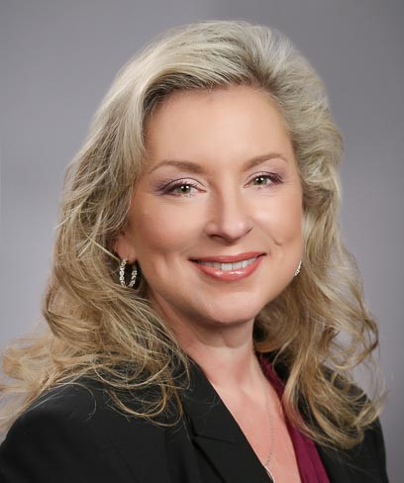
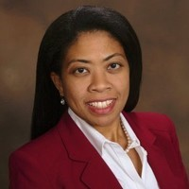
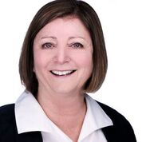
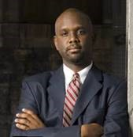

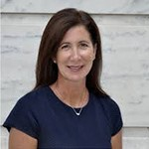


Panelists
Nancy M. Green
Moderator
Co-Chair PCHAlliance Aging & Tech Task Force
Fran Ayalasomayajula
Co-Chair PCHAlliance Aging & Tech Task Force
Sheri Rose
Chris Gibbons
Head of Population Health Worldwide Healthcare, HP
CEO and Executive Director
Thrive Center Inc.
Founder and CEO
The Greystone Group
President
The SAA Group
Leslie Evans
Stuart Patterson
Guests
Senior Director
HIMSS
CEO & Co-Founder
LifePod

Slide 3

Social Determinants of Health Tech Challenge
Presented by HIMSS and Accenture
Tech Solutions to Improve Healthy Aging in Rural Communities

Slide 4



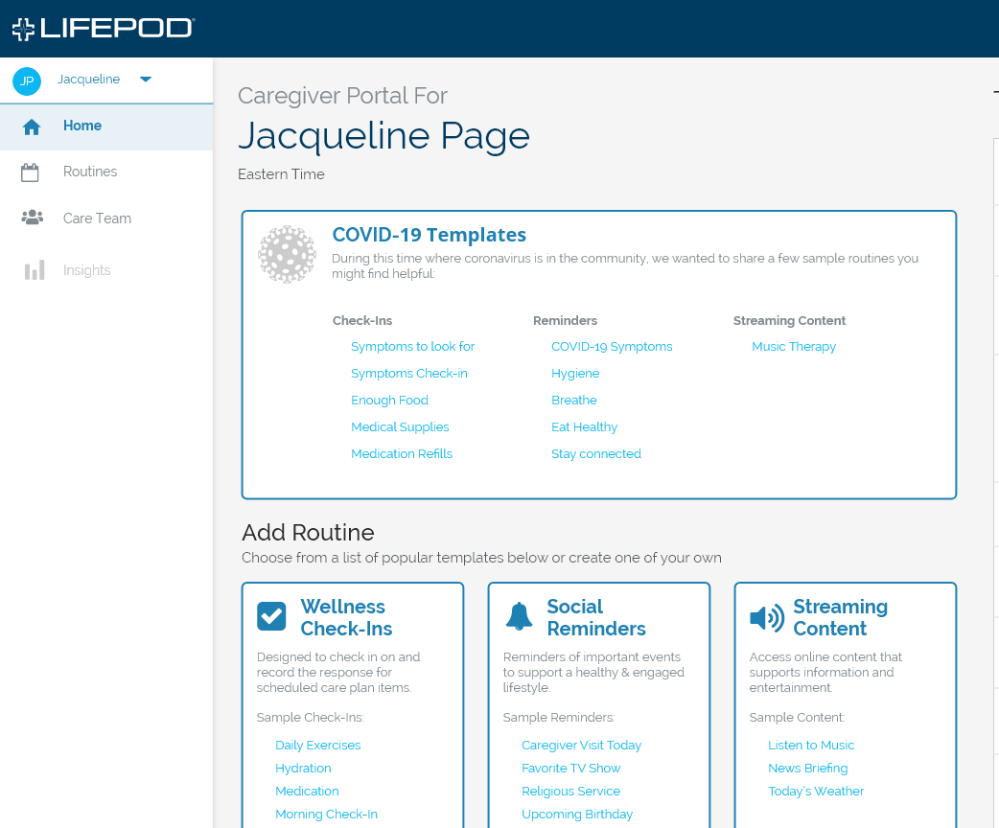
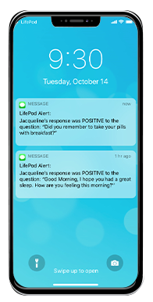



The first, proactive-voice caregiving service …
that enhances personalized, virtual care through dialogs, spoken aloud by LifePod, that interact with and support your members and loved ones.
Good morning, Jackie!
Sarah wanted to see if you’re experiencing any of the following symptoms: fever, cough, shortness of breath, sore throat or body aches?
Proactive
Always-On
Personalized
Data/AI-Driven
Holistic
Affordable
Proprietary & Confidential

Slide 5


Slide 6


Slide 7

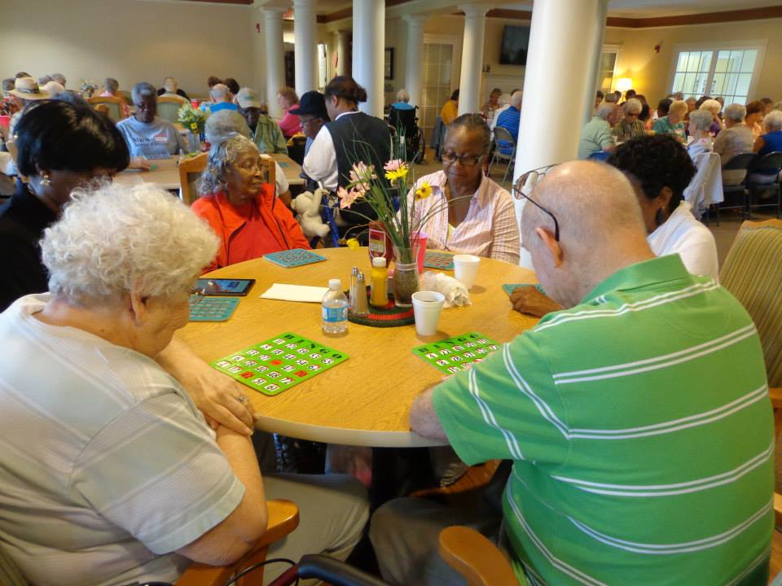

WHAT WE ARE LEARNING FROM COVID-19

Slide 8

The Importance of
Human Centered Design
EXPOSING THE VULNERABILITIES
DESIGNING FOR THE FUTURE
Congregate Living – Our most vulnerable population
Impacts of loneliness and isolation
  Separation from family
Lack of Infrastructure & technology adoption
Home as the healthcare hub
Remote Patient Monitoring
  Wearable technologies
  Ambient Sensors
Voice Assistants
Telehealth
Social Engagement Tools
Virtual Reality

Slide 9


Slide 10


Slide 11
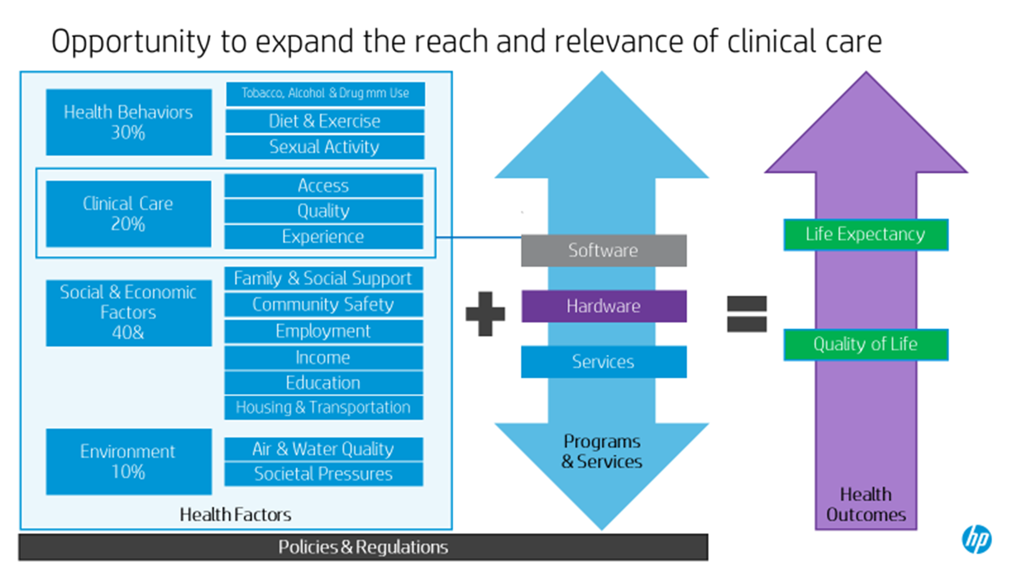

Slide 12
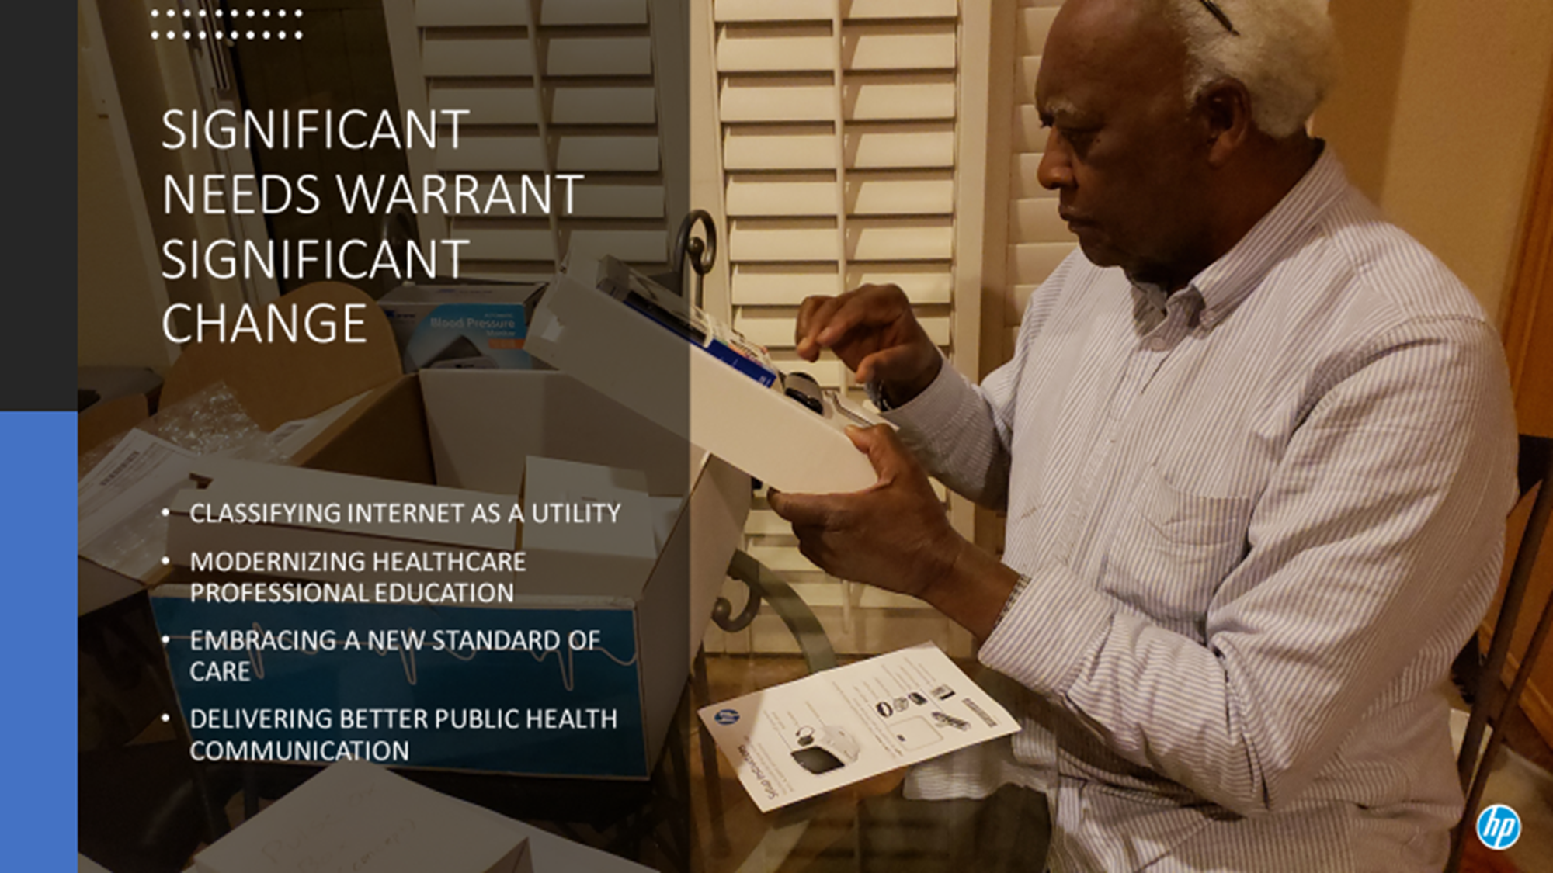

Slide 13
Questions
Please input questions into Chat area of the web program

Slide 14

Panelist and Guest Contact Info
Nancy M. Green
Moderator & Co-Chair PCHAlliance Aging & Tech Task Force
Fran Ayalasomayajula
Co-Chair PCHAlliance Aging & Tech Task Force
Sheri Rose
Chris Gibbons
President
The SAA Group
Nancy@thesaagroup.com
Head of Population Health Worldwide Healthcare, HP
frances.a.walls@hp.com
CEO and Executive Director
Thrive Center Inc.
srose@thriveinnovationcenter.com
Founder and CEO
The Greystone Group
mcg@greystonehit.com
Leslie Evans
Stuart Patterson
Senior Director
HIMSS
LEvans@himss.org
CEO & Co-Founder
LifePod
stuart@lifepod.com

Slide 15
Resources
HIMSS and PCHAlliance COVID-19 initiatives and pages
Industry Call to Action sources, Resources for Individuals, Providers and Vendors – updated continuously
    http://www.pchalliance.org/covid-19-resources
    https://www.himss.org/news/coronavirus
HIMSS Digital Think Tank: submit healthcare’s triage, test, treat COVID-19 successes: https://www.himss.org/news/covid-19-digital-think-tank
HIMSS Analytics Digital Health Indicator https://www.himssanalytics.org/dhi
2. Personal Connected Health Alliance (PCHAlliance), a HIMSS Innovation Company www.pchalliance.or
  Member Engagement and Thought Leadership on Connected Health: Aging & Technology, US Policy including CARES and telehealth, Regulatory including FDA Pre-Cert, European Initiatives like mHealth Hub, Connected Device Interoperability Standards including Continua and IHE
3. CTA, ATA Launch Directory of Telehealth Technologies Amid COVID-19 Pandemic – (https://www.techhealthdirectory.com/)

Slide 16
Invitation: Topic Development and Call for Panelists
Connected Behavioral Health: Technology Addressing Loneliness and Mental Health
Submit topic ideas, abstracts and speaking interest for next HIMSS-PCHAlliance Aging & Tech Webinar: June 2020
Deadline: May 15, 2020
Submissions sent to: Jody Toser, PCHAlliance, jtoser@pchalliance.org
To Join the Aging & Tech Task Force, please email jtoser@pchalliance.org

Slide 17
Thank You!
Recording will be available:
April 27th, 2020
Registered participants will receive notice

