Slide 1
Enterprise Imaging: A Conversation with our Clinical Colleagues
September 09, 2020

Slide 2





Vision
Mission
To realize the full health
potential of every human, everywhere.
Reform the global health ecosystem through the power of information and technology.

Slide 3



Welcome

Slide 4

Cheryl Petersilge, MD, MBA
Cheryl Petersilge is President and Founder of Vidagos, an enterprise imaging strategy firm. A respected physician, imaging leader, and innovative engineer, Dr. Petersilge provides extensive expertise as a pioneer in enterprise imaging with deep knowledge in healthcare informatics.
Dr. Petersilge held numerous Chair and Medical Director positions in radiology and information technology at the Cleveland Clinic. Dr. Petersilge was at the forefront of the movement to design best practices and establish cutting-edge systems that informed the Clinic’s rise to global leadership in enterprising imaging.
She was selected as one of three U.S. representatives on the HIMSS International Center for Excellence for development of the Digital Imaging Adoption Model (DIAM). She leads the HIMSS-SIIM Enterprise Imaging Community Photodocumentation Workgroup. She is the past president of the Society of Skeletal Radiology and provides leadership for numerous professional organizations and advisory boards.

Slide 5
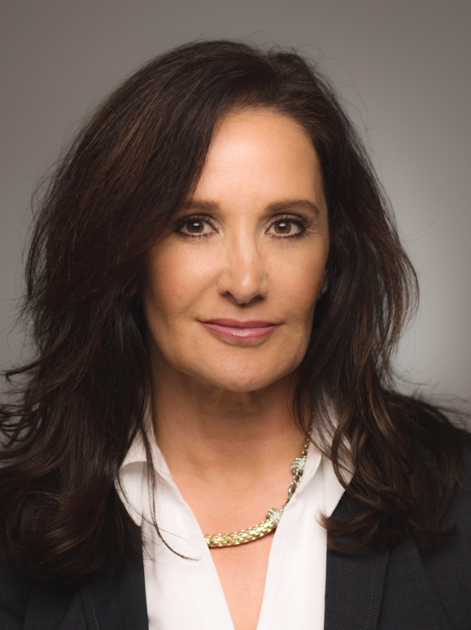
Kim Garriott
As Chief Innovation Officer, Global Healthcare and Life Sciences at NetApp, Kim works with private and public health
sector clients to leverage NetApp technologies to drive innovative data management strategies.
Prior to joining NetApp, Kim served as Data Portfolio Lead for Health & Human Services (HHS), Office of the Chief Technology Officer, Immediate Office of the Secretary. In this role, Kim led the development of a first of its kind data platform & governance model enabling data sharing across the 29 agencies and offices within HHS.
As a consultant, Kim has helped many leading healthcare organizations develop and implement enterprise imaging strategies including the Cleveland Clinic, University of California Health and the University of Chicago Medical Center.
She is a co-founder and current co-chair of the HIMSS-SIIM Enterprise Imaging Community, was chair for the HIMSS Digital Imaging Adoption Model Global Development Team and was named one of HIMSS20 Most Influential Women in Health IT.

Slide 6


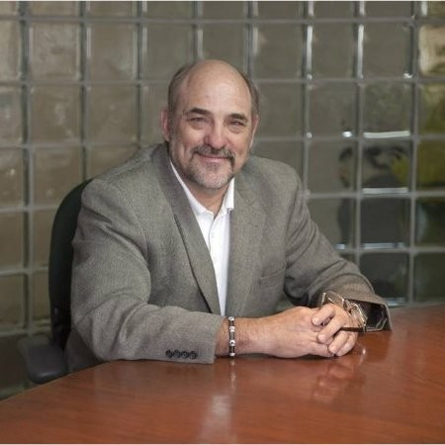

Meet Our Panelists
Lou Lannum
Justin Taylor, MD
Alex Towbin, MD
Principal Consultant
Lannum & Associates
CMIO & Staff Radiologist
Naval Medical Center Camp Lejeune
Associate Chief, Clinical Operations and Informatics
Cincinnati Children's Hospital Medical Center

Slide 7

Panelists request to participants
Engage in the conversation
Respond to the polling questions
Place questions in the Q&A box
Participate by asking to be unmuted

Slide 8
Enterprise Imaging Value Proposition
Priority | Impact
Improved operational efficiency | Streamlines infrastructure Improves provider access to information Standardizes workflows Consolidates teams
Improved data utilization & analytics | Enables shared data governance & data hygiene principles Improves accuracy of diagnostic imaging Increases operational insights leading to improved process efficiency
Telehealth & mobile platform utilization | Supports optimized mobile platform deployment for image viewing Enables mobile patient, provider photograph acquisition & upload Integrates telehealth platforms & image archive
Health information exchange & patient access | Creates single point of image import & export between enterprises Provides foundation for patient access to images and for patient directed image sharing Eliminates media such as CDs
Cybersecurity | Helps expose points of weakness Raises awareness of risks Provides opportunities for education
Petersilge CA. The Enterprise Imaging Value Proposition. J Digit Imaging 2020;33:37-48

Slide 9

Topics
Current State
Enterprise Imaging in the organization
Impact on providers
Role in patient engagement
Population health opportunities

Slide 10

Polling Question
Tell us about your organizations Enterprise Imaging program:
  We have a well-developed program (Full digital image management in at least ten service areas, multiple types of images managed (photo, POCUS, etc).
  We are actively building a program (Full digital management in at least four service areas, multiple type of images managed (photo, POCUS, etc.)
  We are in the early stages of development (Full digital management in at least two service areas).
  We have not yet begun
  We have decided not to create a program

Slide 11

Polling Question
Who should be responsible for Enterprise Imaging?
CIO
CMIO
IT medical director
Chair of Radiology
Other, respond in chat

Slide 12

Polling Question
Does a lack of access to medical images hamper your care of the patient?
Examples:
By location
  Lack of mobile access to images
  Lack of access in the exam room
By image type
  Lack of access to photographs or other images
      Often
      Sometimes
      Not really
Notes:
Examples – Abby Abelson rheum patient after hours consultation, ED consultation

Slide 13
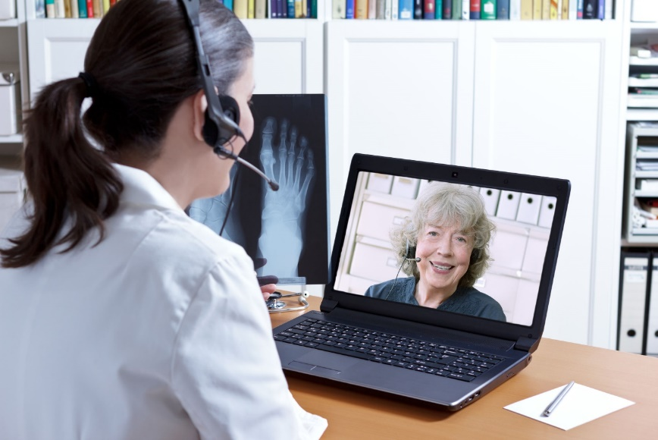
Polling Question
Do you share images with the patient during a clinical visit?
Always
Sometimes
Only if they ask
Never

Slide 14



Role of Population Imaging
Patient reported outcomes
Social determinants of health
Patient engagement
Activity based costing
Risk stratification
Care communication
Enterprise data management
Enhanced clinical decision making
Advanced analytics

Slide 15
Questions?

Slide 16





Education
Community
Present webinars on telehealth, medical informatics, clinical decision support and best use of EHR systems
Volunteer efforts include –CMIO Roundtable & Workgroups, Clinician Circle (ambassador)
Thought Leadership
CMIOs
Value of CMIO; CMIO Roundtable
Policy input, interviews with HIMSS Media; Pre-Con Symposium Planning
Physician Community
Education Task Force
Physician Resources
Drive education and content for Community
Career profiles, education, articles, blogs
www.himss.org/membership-participation/physician
Strategic Partners
AMDIS, PEHRC with CMSS, AHA, Heart Rhythm Society, AMA
Notes:
Add contact

Slide 17


Education
Networking
Quarterly Roundtables; Annual webinar series; conference presentations @ HIMSS, SIIM, & RSNA
Very inter-professional, focus on measureable improvements and insights into enterprise imaging
HIMSS-SIIM Enterprise Imaging Community
Thought Leadership
HIMSS + SIIM
Workgroups published 9 whitepapers on technical, foundational, workflow & governance (n=50K downloads); Three new workgroups on Photodocumentation, Data Standards Evaluation & Multimedia Interactive Content Reporting
Joined forces in 2015 to tackle enterprise imaging challenges; grew via enterprise imaging workgroups and membership outreach
DIAM
Ontology Summit
Analytics Digital Imaging Adoption Model – strategic roadmap to identify and adopt the right digital strategy and improve health outcomes for patients, developed with the leadership of community chair.
Standardization of Body Part Ontology for Enterprise Imaging
www.himss.org/enterprise-imaging
Notes:
YP add contact

Slide 18

Thank you.
Contact:
Yvonne Patrick ypatrick@himss.org
Trisha Pongco tpongco@himss.org

